Slide 1
Applied Architectures
Software Architecture
Lecture 17

Slide 2
Objectives
Illustrate how principles have been used to solve challenging problems
  Usually means combining elements
Highlight some critical issues
  I.e., ignore them at your peril
Show how architecture can be used to explain and analyze common commercial systems

Slide 3
Outline
Distributed and networked architectures
  Limitations
  REST
  Commercial Internet-scale applications
Decentralized applications
  Peer-to-peer
  Web services
Some interesting domains
  Robotics
  Wireless sensors
  Flight simulators

Slide 4
Limitations of the Distributed Systems Viewpoint
The network is reliable
Latency is zero
Bandwidth is infinite
The network is secure
Topology doesn’t change
There is one administrator
Transport cost is zero
The network is homogeneous
-- Deutsch & Gosling

Slide 5
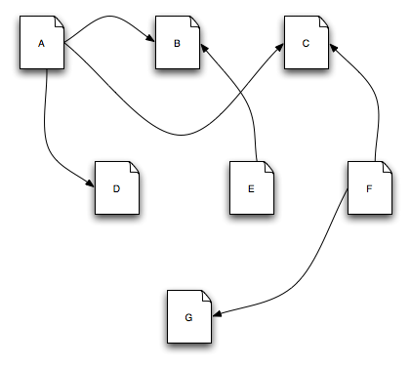
Architecture in Action: WWW
(From lecture #1) This is the Web
Software Architecture: Foundations, Theory, and Practice; Richard N. Taylor, Nenad Medvidovic, and Eric M. Dashofy; © 2008 John Wiley & Sons, Inc. Reprinted with permission.

Slide 6
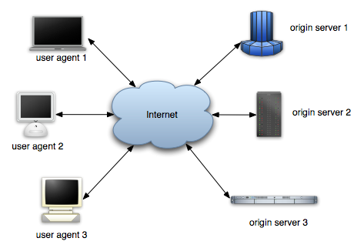
Architecture in Action: WWW (cont’d)
So is this
Software Architecture: Foundations, Theory, and Practice; Richard N. Taylor, Nenad Medvidovic, and Eric M. Dashofy; © 2008 John Wiley & Sons, Inc. Reprinted with permission.

Slide 7
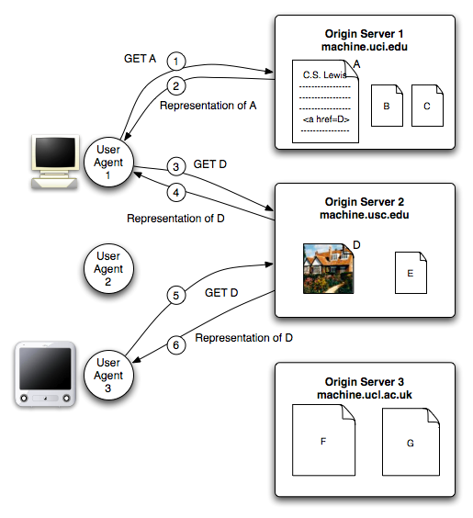
Architecture in Action: WWW
And this
Software Architecture: Foundations, Theory, and Practice; Richard N. Taylor, Nenad Medvidovic, and Eric M. Dashofy; © 2008 John Wiley & Sons, Inc. Reprinted with permission.

Slide 8
WWW’s Architecture
The application is distributed (actually, decentralized) hypermedia
Architecture of the Web is wholly separate from the code
There is no single piece of code that implements the architecture.
There are multiple pieces of code that implement the various components of the architecture.
  E.g., different Web browsers
Stylistic constraints of the Web’s architectural style are not apparent in the code
  The effects of the constraints are evident in the Web
One of the world’s most successful applications is only understood adequately from an architectural vantage point.

Slide 9
REST Principles
[RP1] The key abstraction of information is a resource, named by an URL. Any information that can be named can be a resource.
[RP2] The representation of a resource is a sequence of bytes, plus representation metadata to describe those bytes. The particular form of the representation can be negotiated between REST components.
[RP3] All interactions are context-free: each interaction contains all of the information necessary to understand the request, independent of any requests that may have preceded it.

Slide 10
REST Principles (cont’d)
[RP4] Components perform only a small set of well-defined methods on a resource producing a representation to capture the current or intended state of that resource and transfer that representation between components. These methods are global to the specific architectural instantiation of REST; for instance, all resources exposed via HTTP are expected to support each operation identically.

Slide 11
REST Principles (cont’d)
[RP5] Idempotent operations and representation metadata are encouraged in support of caching and representation reuse.
[RP6] The presence of intermediaries is promoted. Filtering or redirection intermediaries may also use both the metadata and the representations within requests or responses to augment, restrict, or modify requests and responses in a manner that is transparent to both the user agent and the origin server.

Slide 12
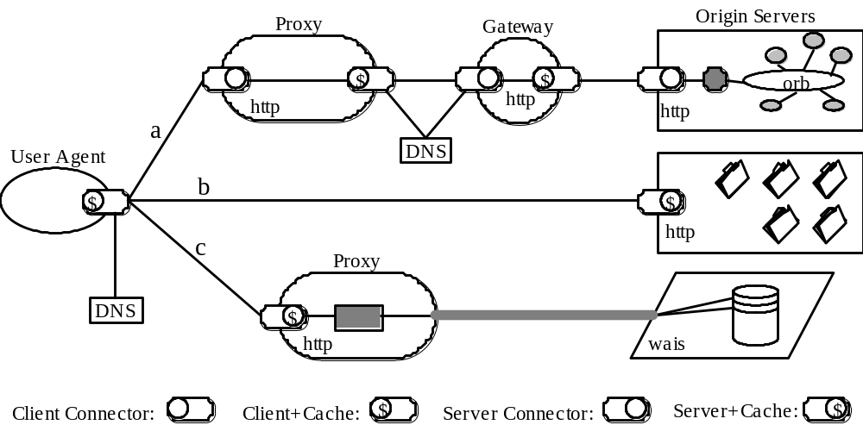
An Instance of REST
Notes:
Process view of a REST-based architecture at one instance in time. A user agent is portrayed in the midst of three parallel interactions: a, b, and c. The interactions were not satisfied by the user agent’s client connector cache, so each request has been routed to the resource origin according to the properties of each resource identifier and the configuration of the client connector. Request (a) has been sent to a local proxy, which in turn accesses a caching gateway found by DNS lookup, which forwards the request on to be satisfied by an origin server whose internal resources are defined by an encapsulated object request broker architecture. Request (b) is sent directly to an origin server, which is able to satisfy the request from its own cache. Request (c) is sent to a proxy that is capable of directly accessing WAIS, an information service that is separate from the Web architecture, and translating the WAIS response into a format recognized by the generic connector interface. Each component is only aware of the interaction with their own client or server connectors; the overall process topology is an artifact of our view.

Slide 13
REST — Data Elements
Resource
  Key information abstraction
Resource ID
Representation
  Data plus metadata
Representation metadata
Resource metadata
Control data
  e.g., specifies action as result of message

Slide 14
REST — Connectors
Modern Web Examples
client libwww, libwww-perl
server libwww, Apache API, NSAPI
cache browser cache, Akamai cache network
resolver bind (DNS lookup library)
tunnel SOCKS, SSL after HTTP CONNECT

Slide 15
REST — Components
User agent
  e.g., browser
Origin server
  e.g., Apache Server, Microsoft IIS
Proxy
  Selected by client
Gateway
  Squid, CGI, Reverse proxy
  Controlled by server

Slide 16
An Instance of REST
Notes:
Process view of a REST-based architecture at one instance in time. A user agent is portrayed in the midst of three parallel interactions: a, b, and c. The interactions were not satisfied by the user agent’s client connector cache, so each request has been routed to the resource origin according to the properties of each resource identifier and the configuration of the client connector. Request (a) has been sent to a local proxy, which in turn accesses a caching gateway found by DNS lookup, which forwards the request on to be satisfied by an origin server whose internal resources are defined by an encapsulated object request broker architecture. Request (b) is sent directly to an origin server, which is able to satisfy the request from its own cache. Request (c) is sent to a proxy that is capable of directly accessing WAIS, an information service that is separate from the Web architecture, and translating the WAIS response into a format recognized by the generic connector interface. Each component is only aware of the interaction with their own client or server connectors; the overall process topology is an artifact of our view.

Slide 17
Derivation of REST
Key choices in this derivation include:
Layered Separation (a theme in the middle portion of diagram) is used to increase efficiencies, enable independent evolution of elements of the system, and provide robustness;
Replication (left side of the diagram) is used to address latency and contention by allowing the reuse of information;
Limited commonality (right side) addresses the competing needs for universally understood operations with extensibility.
The derivation is driven by the application(!)

Slide 18
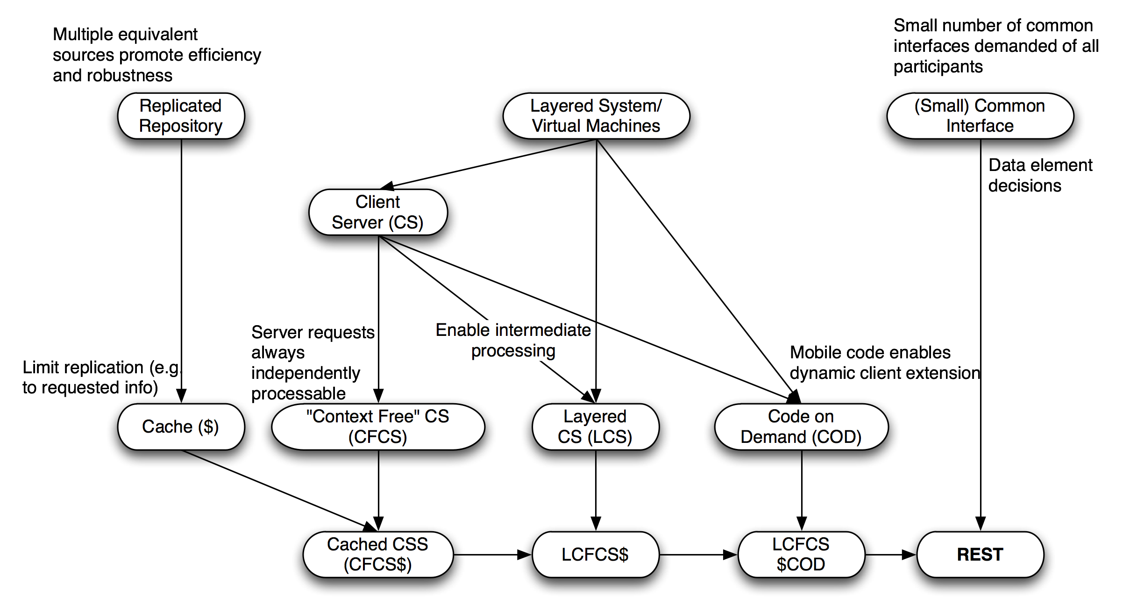
Derivation of REST (cont’d)
Software Architecture: Foundations, Theory, and Practice; Richard N. Taylor, Nenad Medvidovic, and Eric M. Dashofy; © 2008 John Wiley & Sons, Inc. Reprinted with permission.

Slide 19
REST: Final Thoughts
REpresentational State Transfer
Style of modern web architecture
  Web architecture one of many in style
Web diverges from style on occasion
  e.g., Cookies, frames
  Doesn’t explain mashups

Slide 20
Commercial Internet-Scale Applications
Akamai
  Caching to the max
Google
  Google distributed file system (GFS)
  MapReduce
    Data selection and reduction
    All parallelization done automatically

Slide 21
Architectural Lessons from Google
Abstraction layers abound: GFS hides details of data distribution and failure, for instance; MapReduce hides the intricacies of parallelizing operations;
By designing, from the outset, for living with failure of processing, storage, and network elements, a highly robust system can be created;
Scale is everything: Google’s business demands that everything be built with scaling issues in mind;

Slide 22
Architectural Lessons from Google (cont’d)
By specializing the design to the problem domain, rather than taking the generic “industry standard” approach, high performance and very cost-effective solutions can be developed;
By developing a general approach (MapReduce) to the data extraction/reduction problem, a highly reusable service was created.

